Slide 1

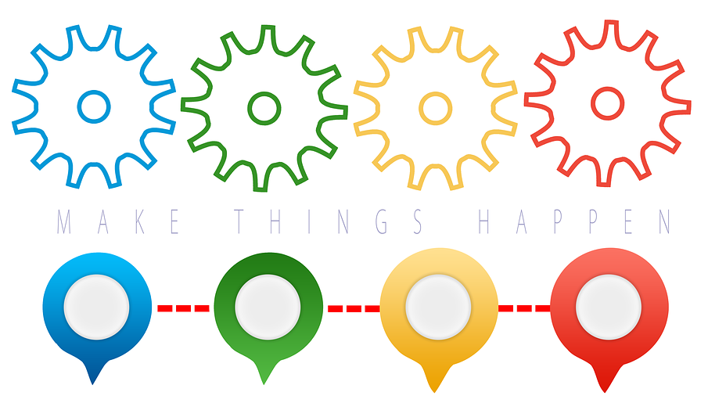
Definition
“Learning styles explain the different ways individuals understand, process, and retain information. Each person has a preferred method of learning.”

Slide 3
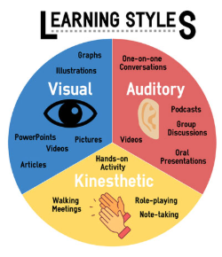
The importance of understanding your Learning Style
Educational experts have shown that by becoming more aware of how you learn, you can become a better learner.
It has been shown that there are many different methods of learning and what works best depends on the task, the situation and your personality.
We can become more effective learners if we are aware of the different learning methods and understand what works best for us.
There are two main elements involved in understanding how we learn:
  (1) Find out what our most dominant learning style is, whether it is Visual, Auditory or Kinaesthetic. The VAK model is useful here.
  (2) Find out how our brains manage and process the information, whether it is Practical, Active, Reflective or Objective. The PARO model is what we can use to understand this.

Slide 4
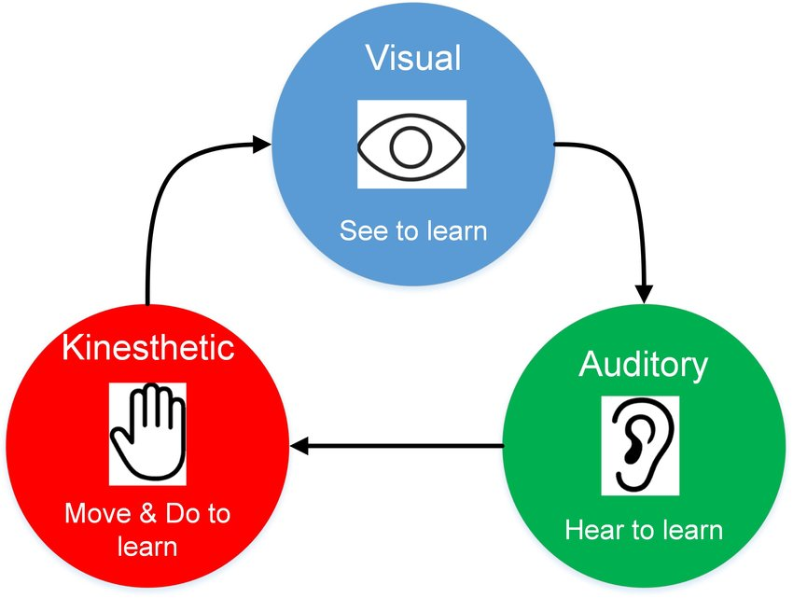
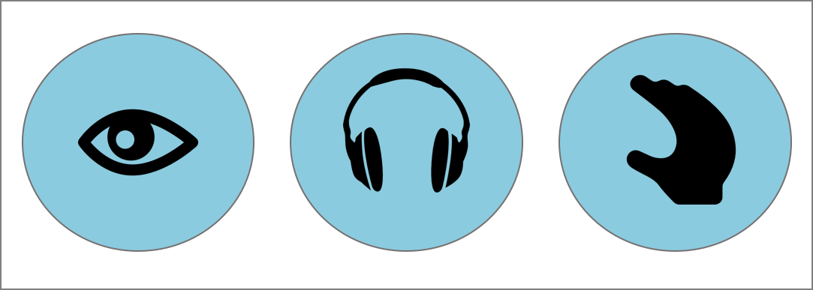
The VAK model
Learning Styles are the ways in which people learn.
The VAK model is one of the most simple ways to explain these by using the three main sensory receivers of Visual, Auditory and Kinaesthetic (or VAK for short).
Some people find that they learn best by using their eyes to pick up information (Visual), others take in information better when they hear or discuss a topic (Auditory), while others still can learn best through practical, hands-on activities (Kinaesthetic).
Most people will possess a dominant style of learning or have a mix of all three styles.

Slide 5

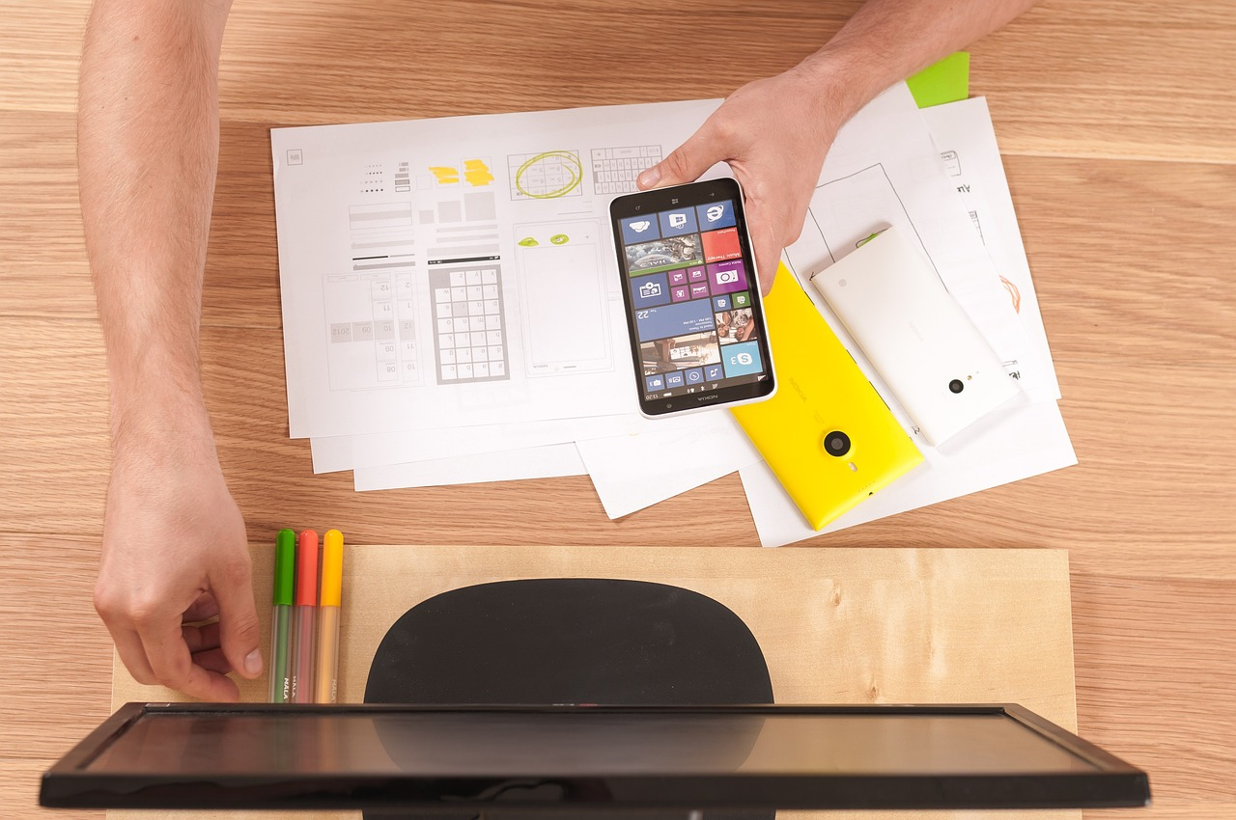
Approximately 29% of us are Visual Learners.
This means we learn easiest by what we can see.
Visual learners prefer to take in information by reading and using visual materials such as pictures, charts, and maps.
A Visual learner may find it hard to remember spoken directions and may become easily distracted by noise.
Advice for Visual Learners
Use colour to highlight texts and own notes
Take notes or use handouts; look carefully at headings and patterns of topics
Use illustrations, mind maps and models
Use multi-media where possible (e.g. computers; mind maps)
Study in a quiet place away from disturbances
Visualise information as a picture
Skim-read to get an overview before reading in detail

Slide 6
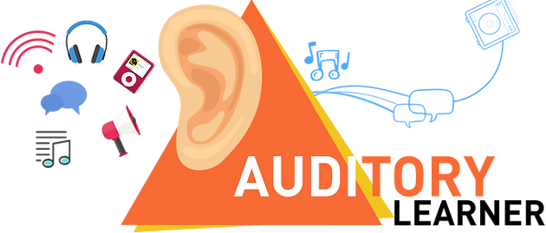

Advice for Auditory Learners
Participate in discussions and debates.
Make speeches and presentations whenever possible.
Read text out loud.
Use your phone to record your ideas and/or notes and play them back as a form of revision.
Discuss your ideas.
Approximately 34% are Auditory Learners.
This means that we learn information based on what we hear.
Auditory Learners prefer to take in information by listening, discussing and debating things.
An Auditory learner might find noise distracting. They might find diagrams difficult to understand.

Slide 7

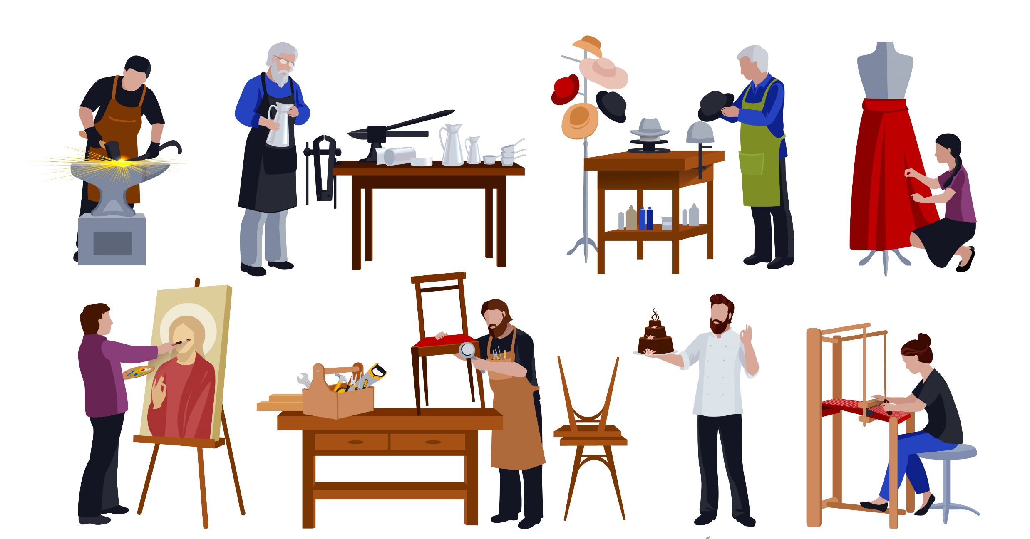
Approximately 37% of are Kinaesthetic Learners.
This means that we learn best by using our hands and by doing a task.
Kinaesthetic learners prefer to be hands-on and like to move, build and draw rather than listen or watch.
A Kinaesthetic learner might have difficulty in sitting and listening for long periods of time.
Advice for Kinaesthetic Learners
Study in a comfortable position, not necessarily sitting in a chair. Stand up while working can be helpful.
Use flash cards, which you can shuffle frequently.
Use touch, action, movement and hands-on learning wherever possible.
Skim-read before reading in detail.
Use bright colours to highlight reading material and turn it into posters or models.
Move around to learn notes (e.g. read while you are using an exercise bike or walking around)

Slide 8
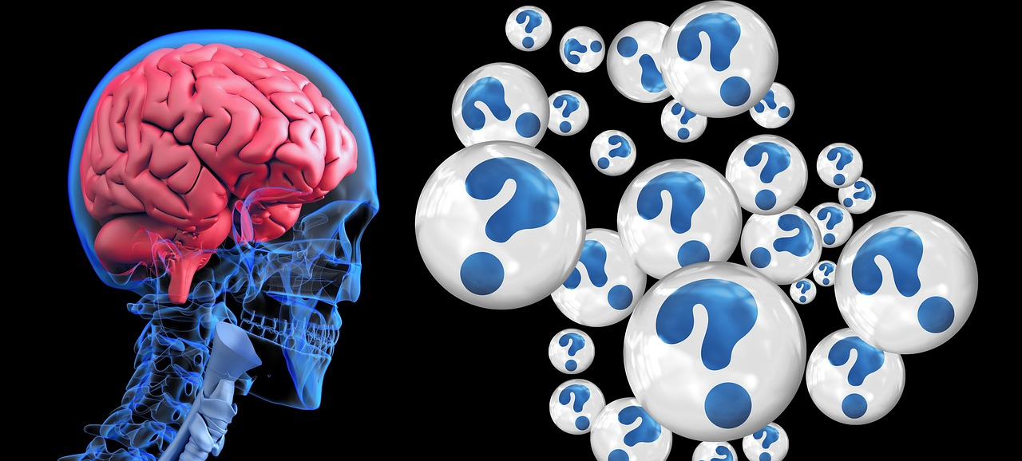
The PARO model
Our brains make sense of information and learns in different ways.
The PARO model identifies four distinct styles or preferences that people use to process the information we take in while learning. Most of us tend to follow only one or two of these styles.
Understanding our top learning style can help us find ways to learn more effectively.
The Practical style for people who like to try out ideas and techniques to see if they work out.
The Active style for those who like the challenge of new ideas.
The Reflective style for people who like to consider information carefully before coming to a conclusion.
The Objective style for those who tend to think through problems in a logical, analytic way.

Slide 9

Practical Learners
Practical learners like to try things out and look for ideas that they can use to sort out problems.
They like to get on with things and are practical people.
They tend to be quite straightforward, saying what they mean, and can be blunt and to the point.
They like everything to have its place, are very organised and they find lists and schedules useful.
Practical learners can have difficulty considering alternatives, having to make decisions without enough information and can find visualising abstract things difficult.
How Practical Learners can improve their learning
Write down any work or study clearly, as you may have difficulty following unclear directions.
Practise flexibility and try to find new ways of doing things.
Try to make what you’re studying relevant in order to make it more meaningful for yourself.

Slide 10
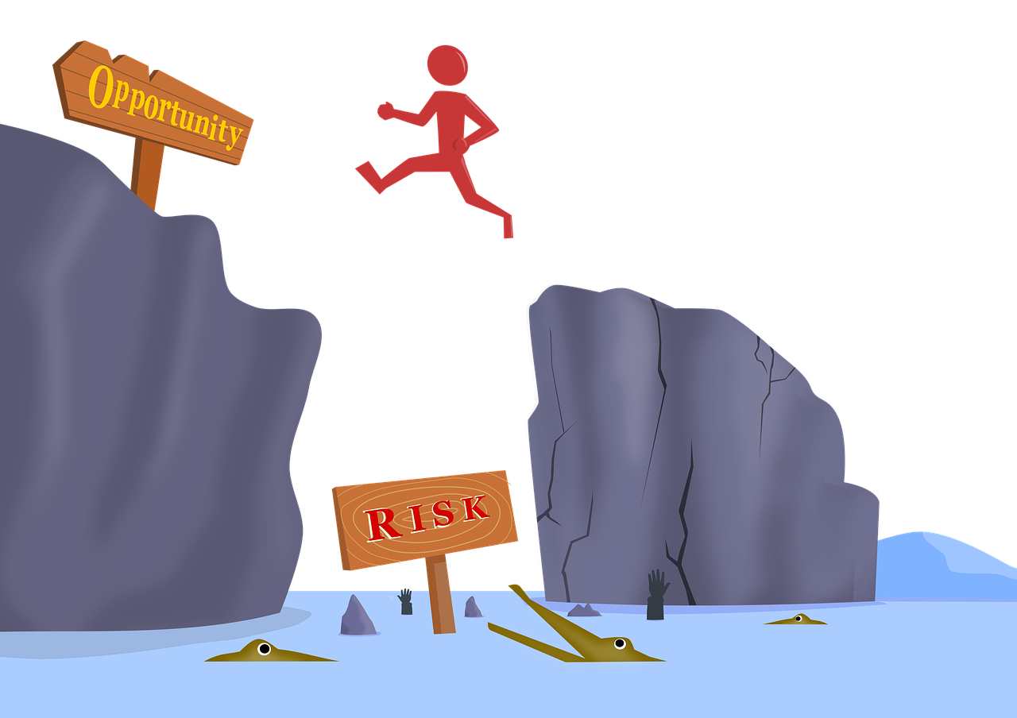
Active Learners
Active learners are people who learn by doing. They like to involve themselves in new experiences and will ‘try anything once’.
Active learners have a curious and investigative nature and like to invent new ways of solving problems.
They are not afraid to take risks and they like to think of the possibilities of what ‘could be’.
They like variety and change but are inclined to get bored with seeing things through and can have difficulty with predictable and structured environments.
How Active Learners can improve their learning
Read instructions and directions carefully and pay attention to the steps you take.
Learn by ‘doing’ with a trial-and-error approach.
Avoid procrastination and distractions. Always try to focus on the task at hand!

Slide 11

Reflective Learners
Reflective learners learn by observing and thinking about what happened. They tend to be cautious and thoughtful.
They like to consider all the possible angles and personal implications before coming to a considered opinion..
They value relationships above all and learn best in a friendly environment. They have a talent for understanding human nature.
Reflective learners can have difficulty with remembering precise details and facts. They tend not to take the lead in a group, while timekeeping can also be an issue.
How Reflective Learners can improve their learning
Studying in a group can help reflective learners.
Ask for feedback from teachers and learn to accept constructive criticism.
Get into the habit of keeping a schedule and set goals for yourself.
Learn to be more objective – take your feelings and opinions out of your work when necessary.

Slide 12

Objective Learners
Objective learners like to understand the theory behind why things are as they are.
They like to analyse things rather than have opinions that are based solely on personal views. They prefer research and like to organise the information.
Objective learners like to think problems through in a logical, step-by-step manner. They tend to choose their words carefully.
They tend not to make decisions until all of the pros, cons and facts are established and can have difficulty with making their minds up quickly.
How Objective Learners can improve their learning
Become familiar with all the questions which might appear on an exam as dealing with surprises may be challenging.
Find a way to apply structure and lay out your arguments logically and concisely.
Find a balance between gathering information for a task, and actually doing the task.
Make sure you have routine work completed before you forget it.

Slide 13
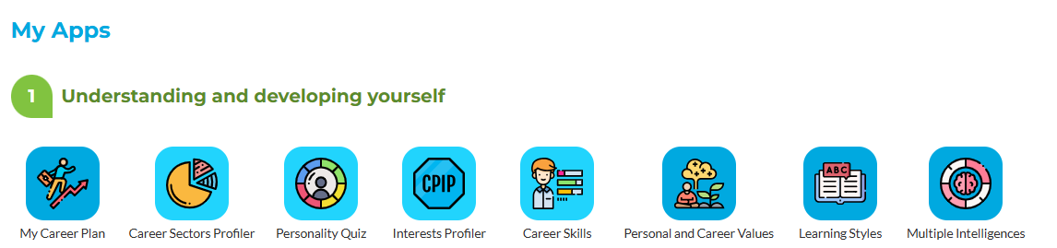
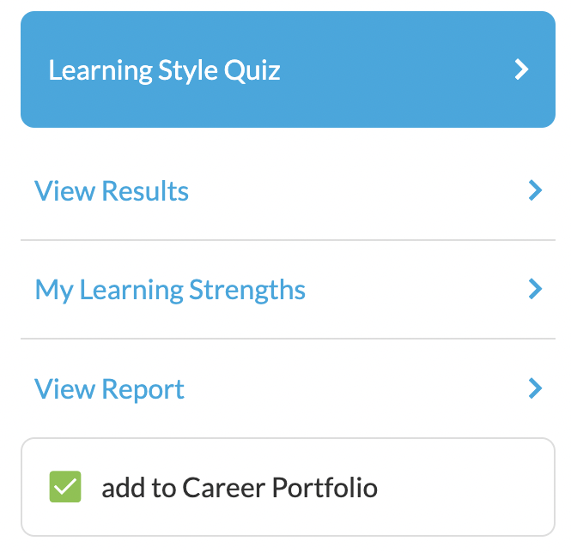
Completing the Learning Styles App
Step 1:In your MyFuture+ career file, select the Learning Styles Icon. Then simply click on the ‘Learning Style Quiz’ button to begin…
Step 2: Click on the ‘Learning Style Quiz’ button to begin…

Slide 14
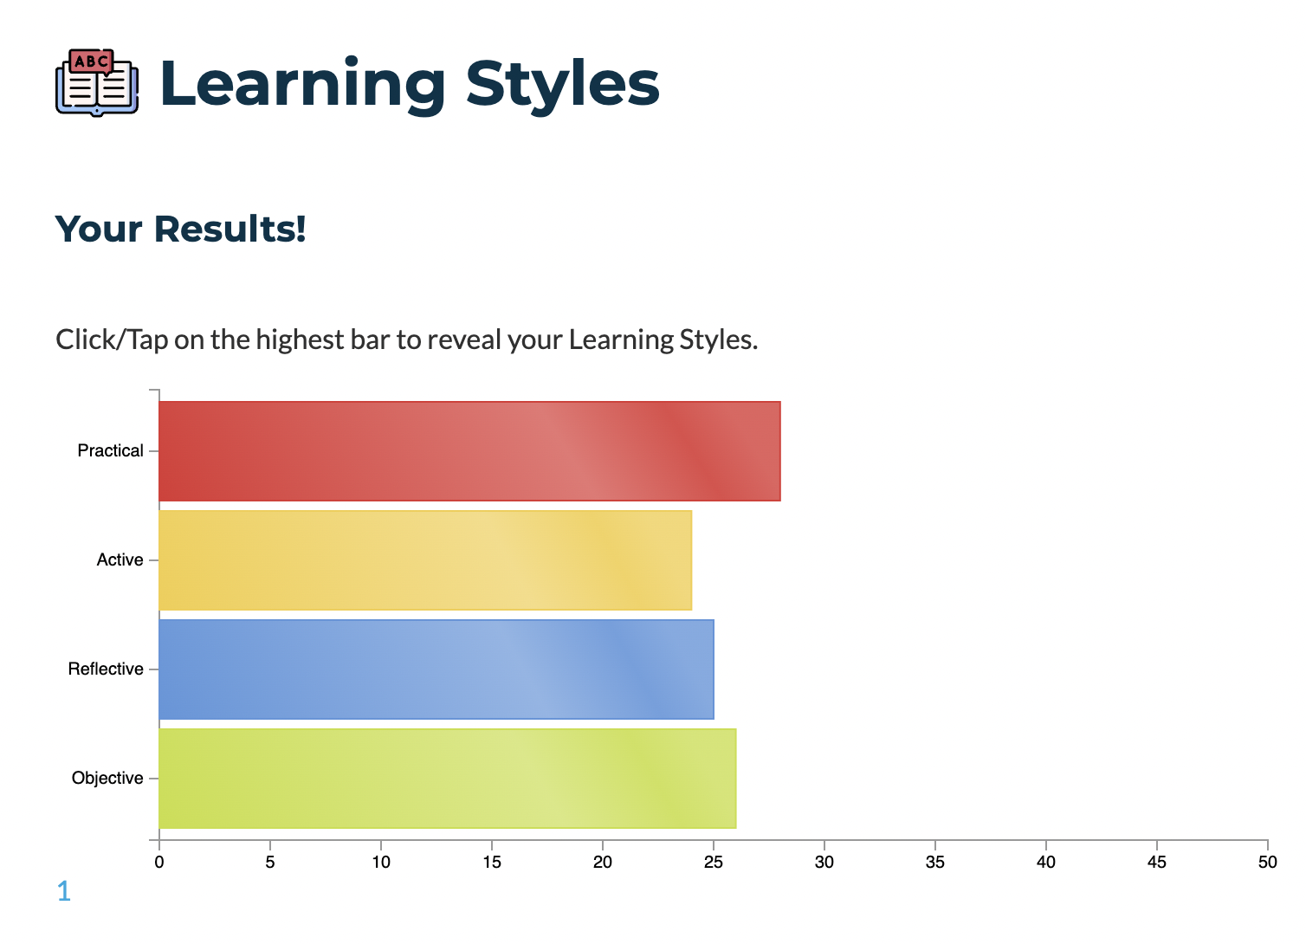
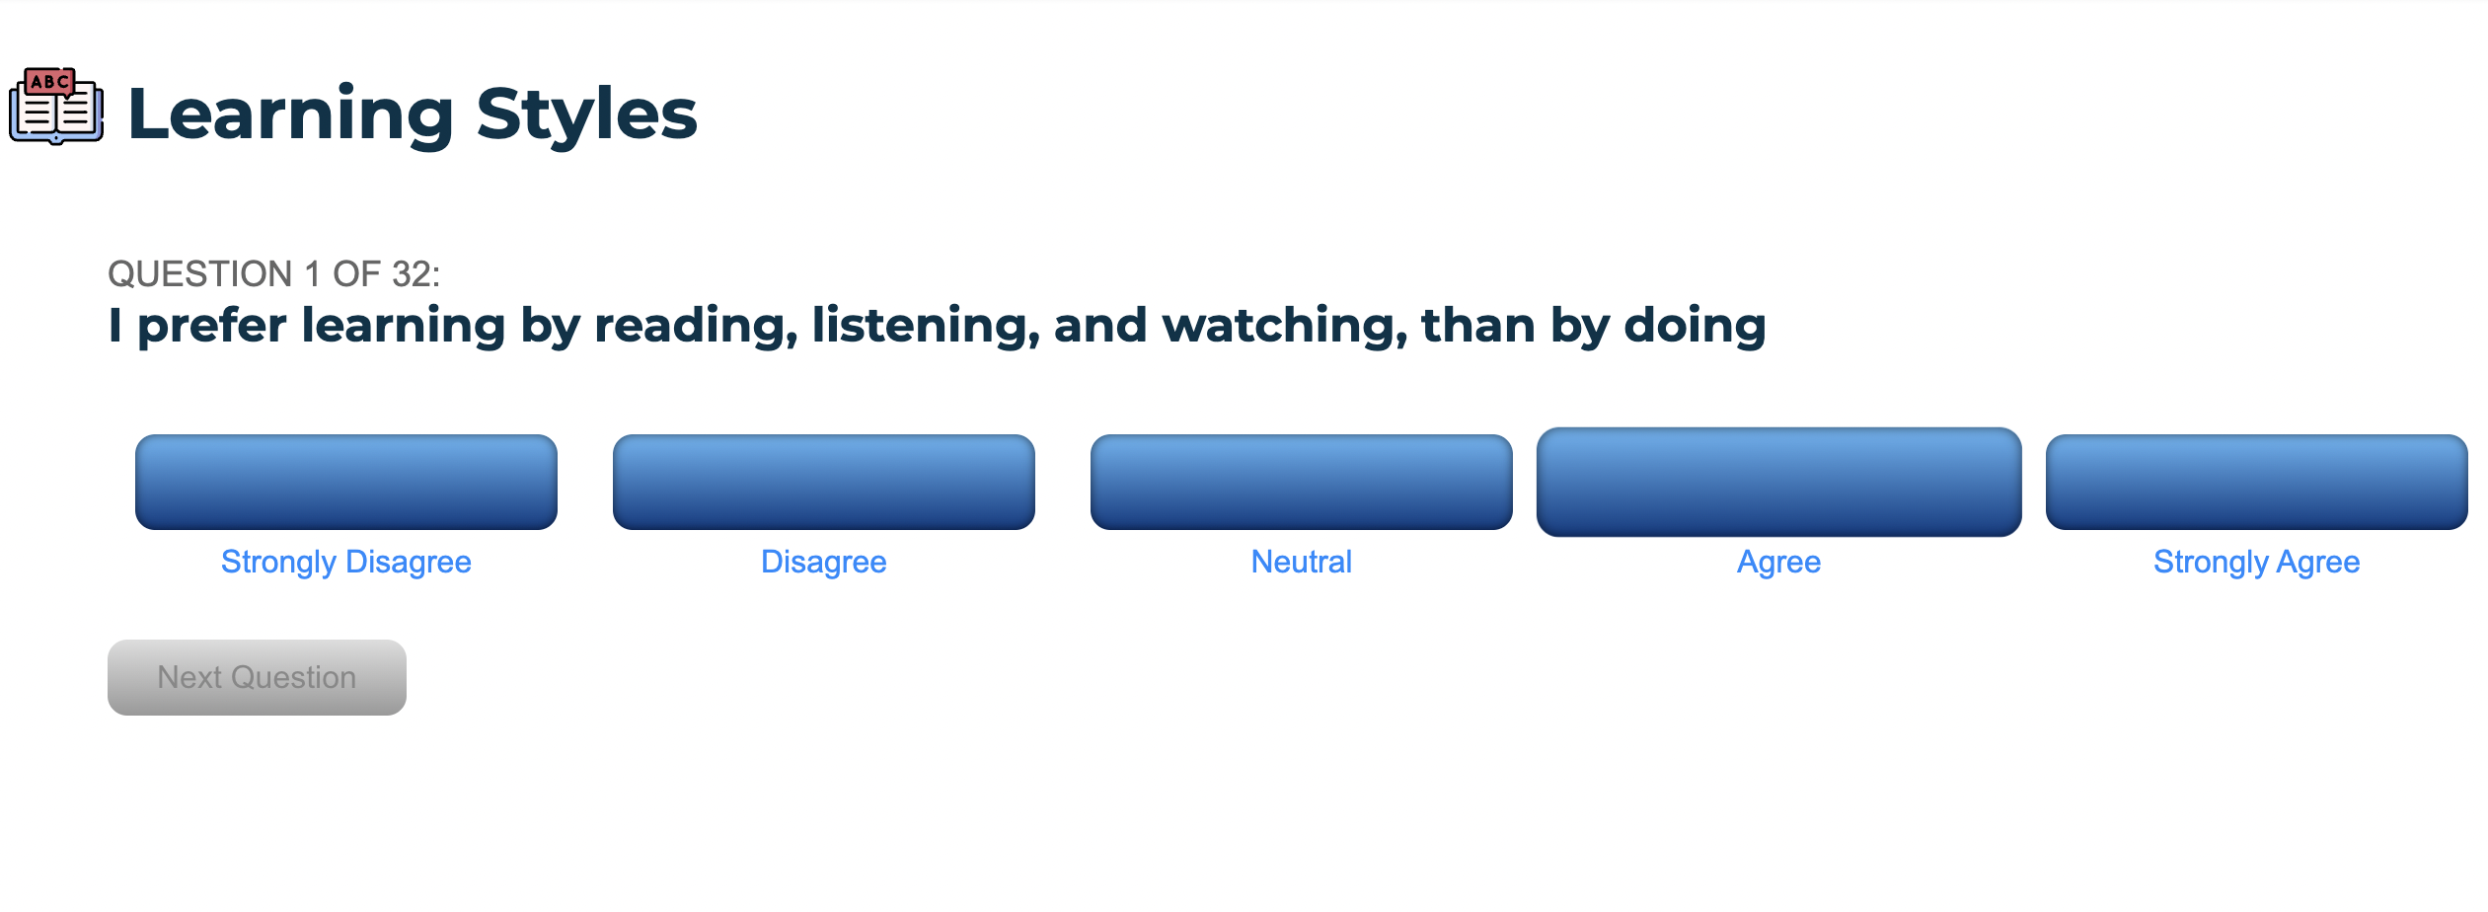
Step 3: Take your time and give a considered answer to each statement in the Learning Styles Quiz
When you complete the quiz, you will receive your results in the form of a bar chart. Click on the highest bar to reveal your most prominent Learning Style.

Slide 15

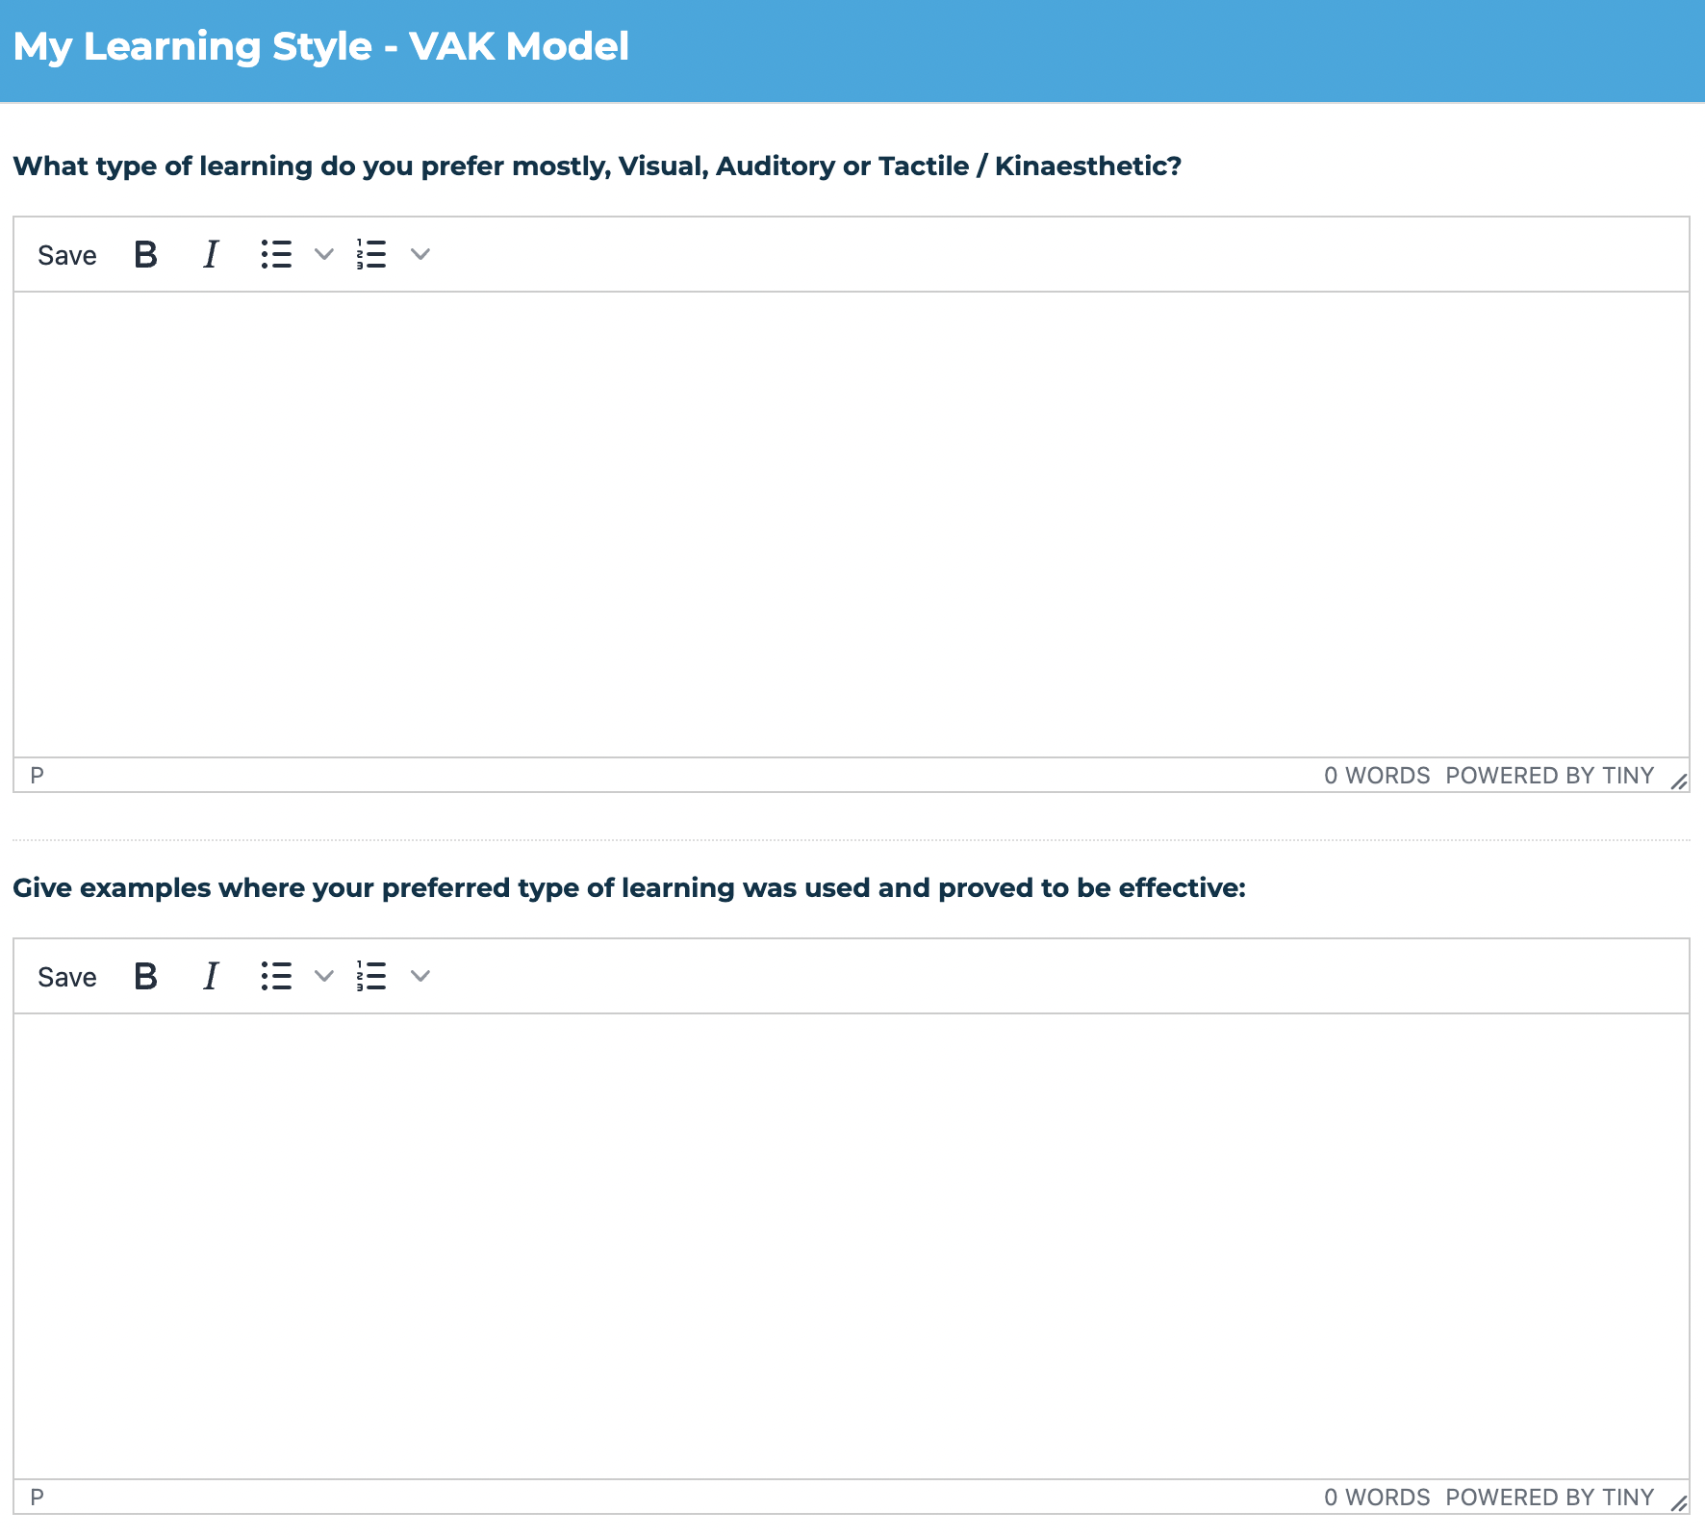
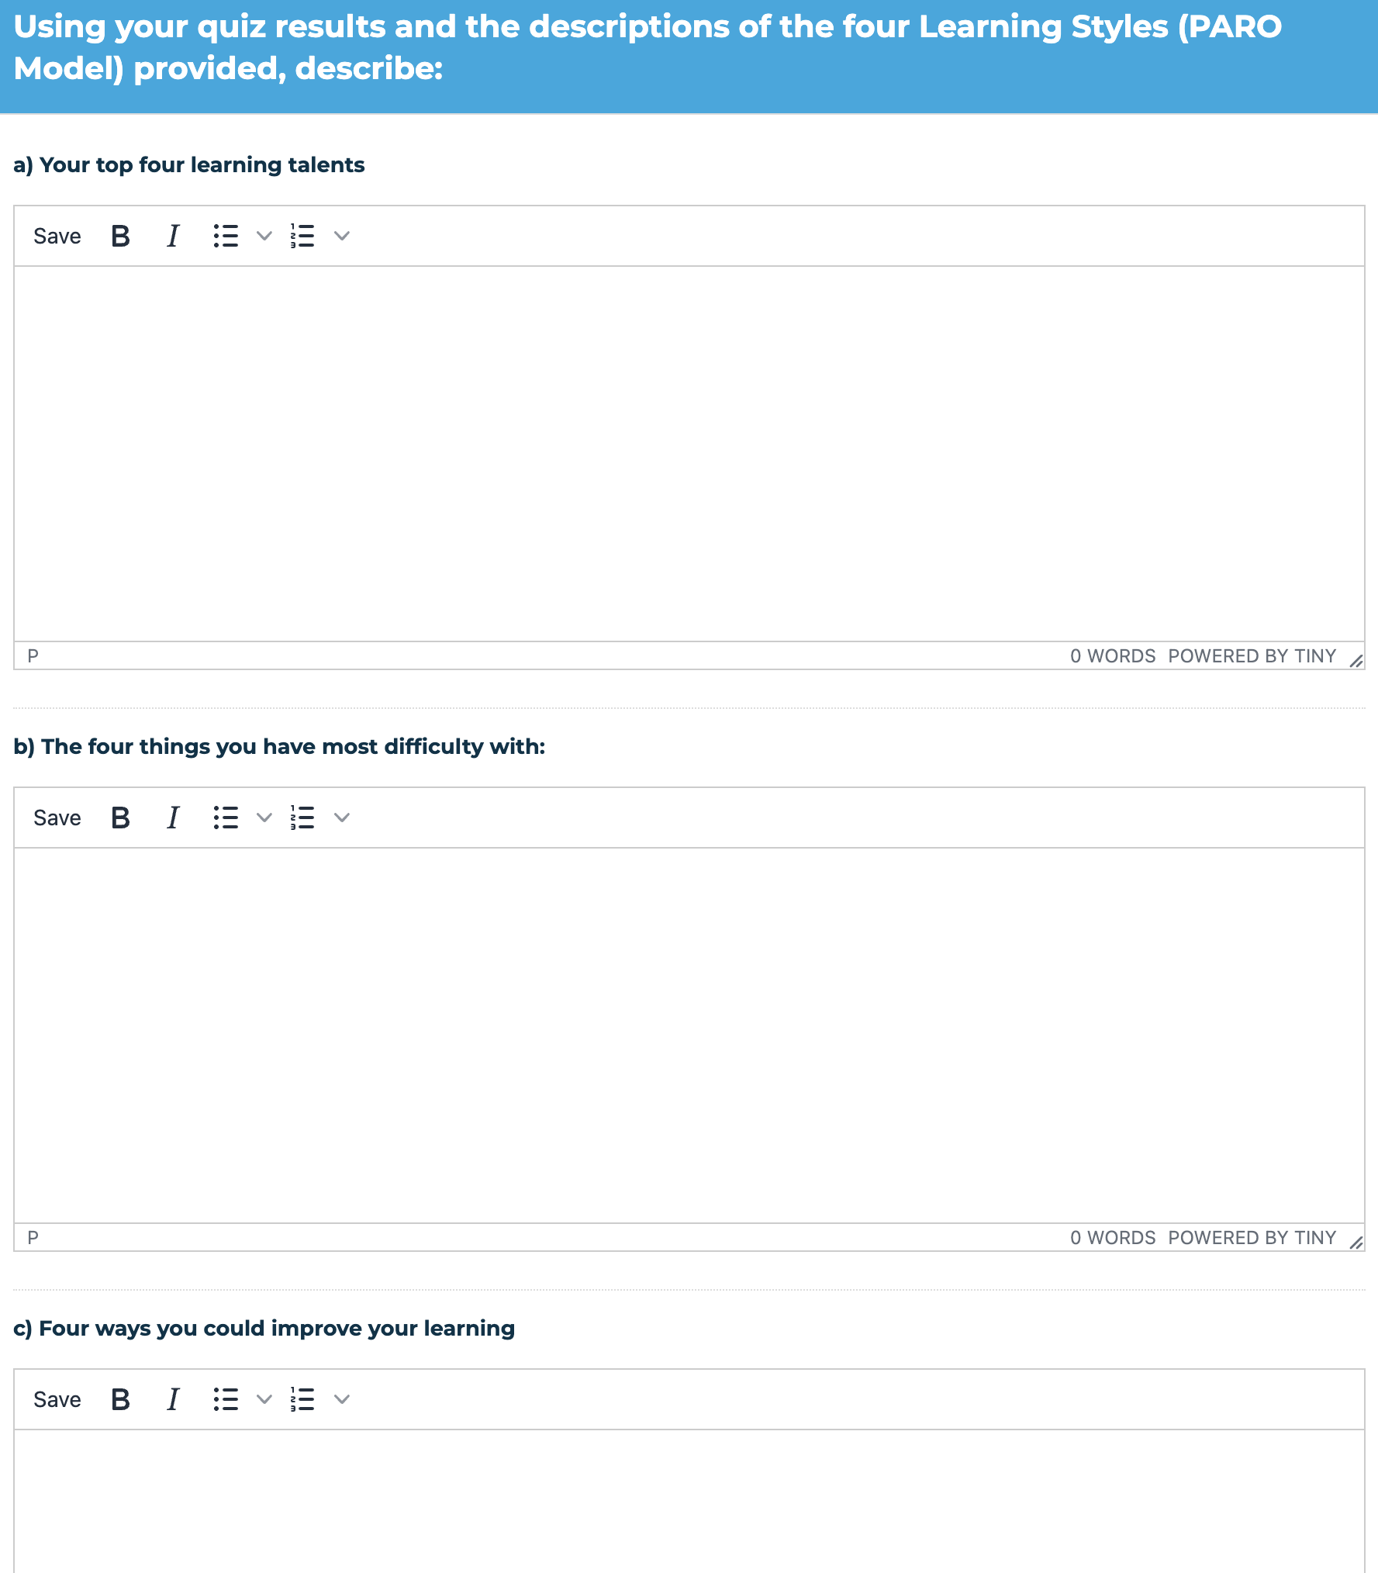

Exercise: Learning Styles Reflection
It is important to include your thoughts and learning on your top learning styles – VAK and PARO

Slide 16
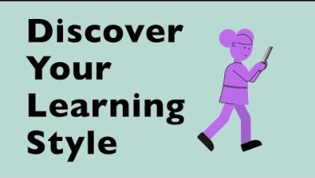
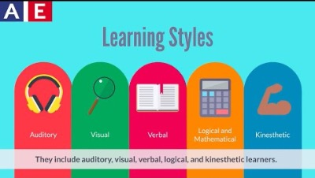
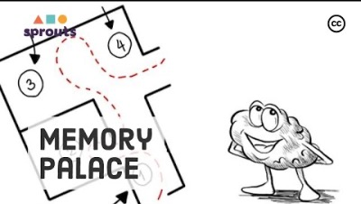
Learning Styles Videos
3.5-minute video. About discovering what your learning style is
2.5-minute video. Explaining the different learning styles and why it is important to know your own
3.5-minute video. Interesting short video on how to improve your memory when studying

Slide 17
Know the importance of Learning Styles
Understand the VAK Model is and be able to work out your own Individual Learning Style
Explore what is meant by Information Processing and what the PARO Model is
Complete the Learning Styles App and understand your preferred way to learn
Understand how you can use the information to help Improve Your Learning and Study habits

